Slide 1

PITTSBURG
WRESTLING CLUB
2026–27 PARENT MEETING
Monday, October 12 • 5:30 PM • SEK Elite
BUILDING DRAGONS ON AND OFF THE MAT

Slide 2
PWC • 2026–27
Tonight’s game plan
GET READY
GET INVOLVED
Welcome & coaching team
Tournaments & communication
Season structure and practices
Gear, safety and expectations
Registration, USAW and fees
Fundraising, dates & questions
Scan the QR codes on the registration, gear and contact slides.
PWCDragons.org
02

Slide 3
PWC • 2026–27
Our board & coaches
BOARD OF DIRECTORS
COACHING STAFF
LC Davis • Carrie Lance
LC Davis • Josh Lattimer
Josh Lattimer • Will Peden
Jordan Michael Brown • James Ryan
James Ryan • Mindi Jones
Nolan Richie • Izzy Renfro
Dillon Hooper • Seth Gann
Coaches may adjust team placement based on safety, readiness and skills.
PWCDragons.org
03

Slide 4
PWC • 2026–27
Which group is right for your wrestler?
NOVICE | $100
OPEN | $130
Less than 2 years of experience
Typically 2+ years and core skills
Focus: fundamentals, confidence & safety
Higher-paced drilling and mat awareness
Movement to Open determined by coaches
Middle schoolers join the Open group
Programs serve Pre-K through high school; HS participation is limited to eligible 14U wrestlers after the HS season.
PWCDragons.org
04

Slide 5
PWC • 2026–27
Registration & season fees
SEASON DUES
REGISTRATION REQUIREMENTS
Open: $130 per wrestler
USA Wrestling membership card required FIRST
Novice: $100 per wrestler
Then register at PWCDragons.org
Middle school: $100 per wrestler
Required paperwork & physical on file
Additional siblings: $50 off each
Dues or approved minimum down payment
Payment help is available—contact the club. SEK Elite access is included for registered Open & Novice wrestlers during the season.
PWCDragons.org
05

Slide 6
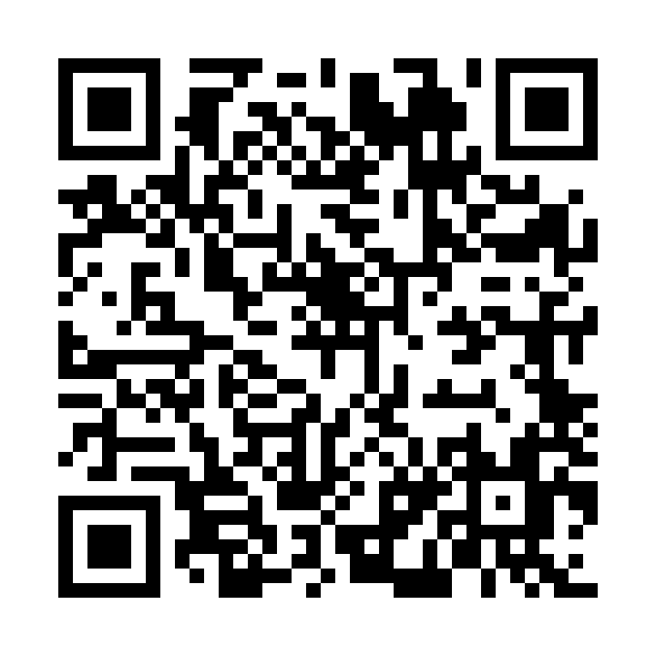
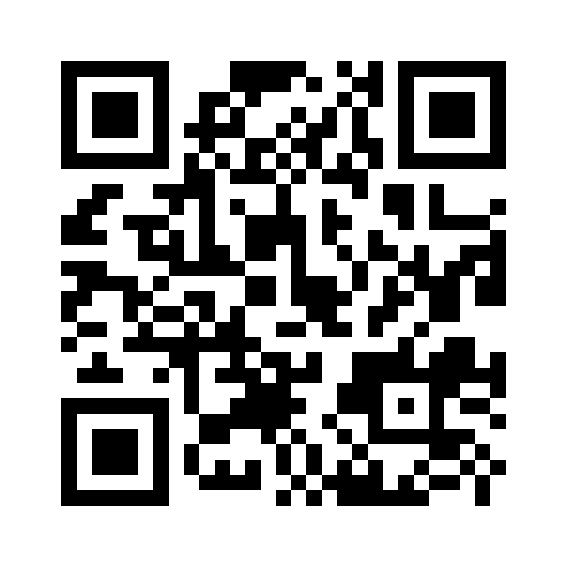
PWC • 2026–27
Two places to register
STEP 1: USA WRESTLING
STEP 2: PWC REGISTRATION
Active USAW card REQUIRED before club registration
Register after obtaining your USAW membership
usawmembership.com/login
PWCDragons.org
Two separate registrations • USAW membership is mandatory to register with PWC.
PWCDragons.org
06

Slide 7
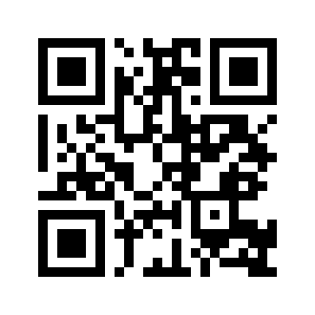
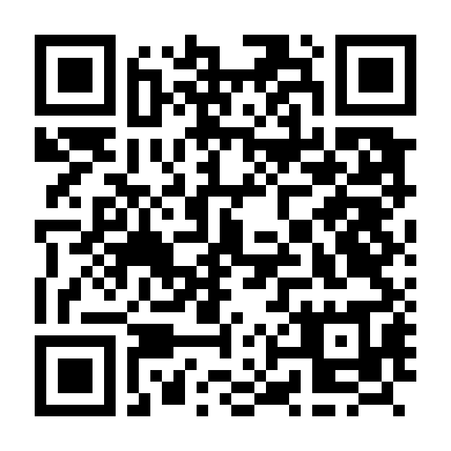
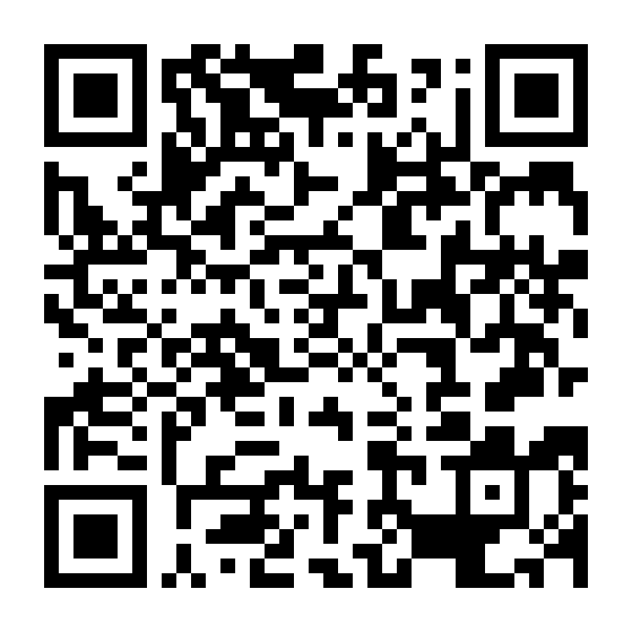
PWC • 2026–27
WrestlingIQ • your season hub
HOW TO ACCESS IT
WHAT YOU WILL USE IT FOR
1. Visit PWCDragons.org and click Register
Club calendar and important dates
2. That takes you to WrestlingIQ to complete registration
Future tournament registrations
3. Once registered, log in through the app or at WrestlingIQ.com
Club messaging — our primary communication tool
Fast updates for schedule changes, weather and reminders
APPLE APP STORE
GOOGLE PLAY • ANDROID
WrestlingIQ.com
We will still post on Facebook, but WrestlingIQ messaging is the fastest and most important place for information because it sends notifications directly to your phone.
PWCDragons.org
07

Slide 8
PWC • 2026–27
Practice schedule • PHS Wrestling Room
NOVICE
OPEN
Mondays & Wednesdays
Tuesdays & Thursdays
Starts the week of December 1
6:00–7:30 PM
Season packet lists December 2 start
Packet lists December 3 start
Scheduled through early February
Runs through March 12, 2027
Practice days and start dates are subject to change—follow WrestlingIQ for confirmed updates.
PWCDragons.org
08

Slide 9
PWC • 2026–27
SEK Elite • additional practice opportunities
MON & WED
6:00–7:30 PM
Open
TUESDAY
5:30–6:30 PM
Girls / Open • 1+ year experience
THURSDAY
5:30–6:30 PM
Novice
FRIDAY
5:00–6:00 PM
Open
Included with PWC season dues for registered Open / Novice wrestlers • Dec 1–Mar 12
PWCDragons.org
09

Slide 10
PWC • 2026–27
Room rules: the Dragon standard
Pay attention when coaches teach
Give 100% effort throughout practice
Work through frustration and ask for help
No talking while coaches are instructing
Respect teammates, opponents and coaches
Parents are welcome to stay; please take side conversations outside the room.
PWCDragons.org
10

Slide 11
PWC • 2026–27
Practice gear & wrestler hygiene
BRING TO PRACTICE
KEEP OUR TEAM HEALTHY
Wrestling shoes only on the mat
Shower promptly after practices
T-shirt and shorts / athletic clothes
Wash practice clothes between uses
Headgear strongly recommended
Clean/disinfect shoes & headgear
Water bottle and ready-to-learn attitude
Tell coaches about suspicious skin issues
Tournament days: bring singlet, wrestling shoes and headgear; mouthguard if braces.
PWCDragons.org
11

Slide 12
PWC • 2026–27
Tournament season • what parents should know
Events are usually on Saturdays or Sundays; many have split sessions
Age group is based on wrestler’s age on August 31
Weight verification / weigh-ins are required
Typical tournament entry fees: approximately $20–$30
Club registration cutoffs are firm—register on time
Common age groups: 6U • 8U • 10U • 12U • 14U • HS
PWCDragons.org
12

Slide 13
PWC • 2026–27
Tournament entries & mat-side coaching
DO THIS
DON’T DO THIS
Find the event in WrestlingIQ
Do not self-register through Trackwrestling
Read the flyer and registration deadline
An independent entry may disrupt the club list
Complete required entry info and payment
Coaches track bouts using team registrations
Check session, weigh-in and mat time
Trackwrestling / USA Bracketing = brackets
WrestlingIQ is our primary source for event details, sign-ups and schedule changes.
PWCDragons.org
13

Slide 14
PWC • 2026–27
Tournament announcements coming soon
TOURNAMENT SCHEDULE
COMING SOON
WHAT TO EXPECT
WHERE TO FIND THEM
The club is still selecting tournaments
WrestlingIQ calendar is the official source
We will announce events when confirmed
Dates, flyers and entry details posted there
Watch WrestlingIQ for the finalized schedule and tournament registration deadlines.
PWCDragons.org
14

Slide 15
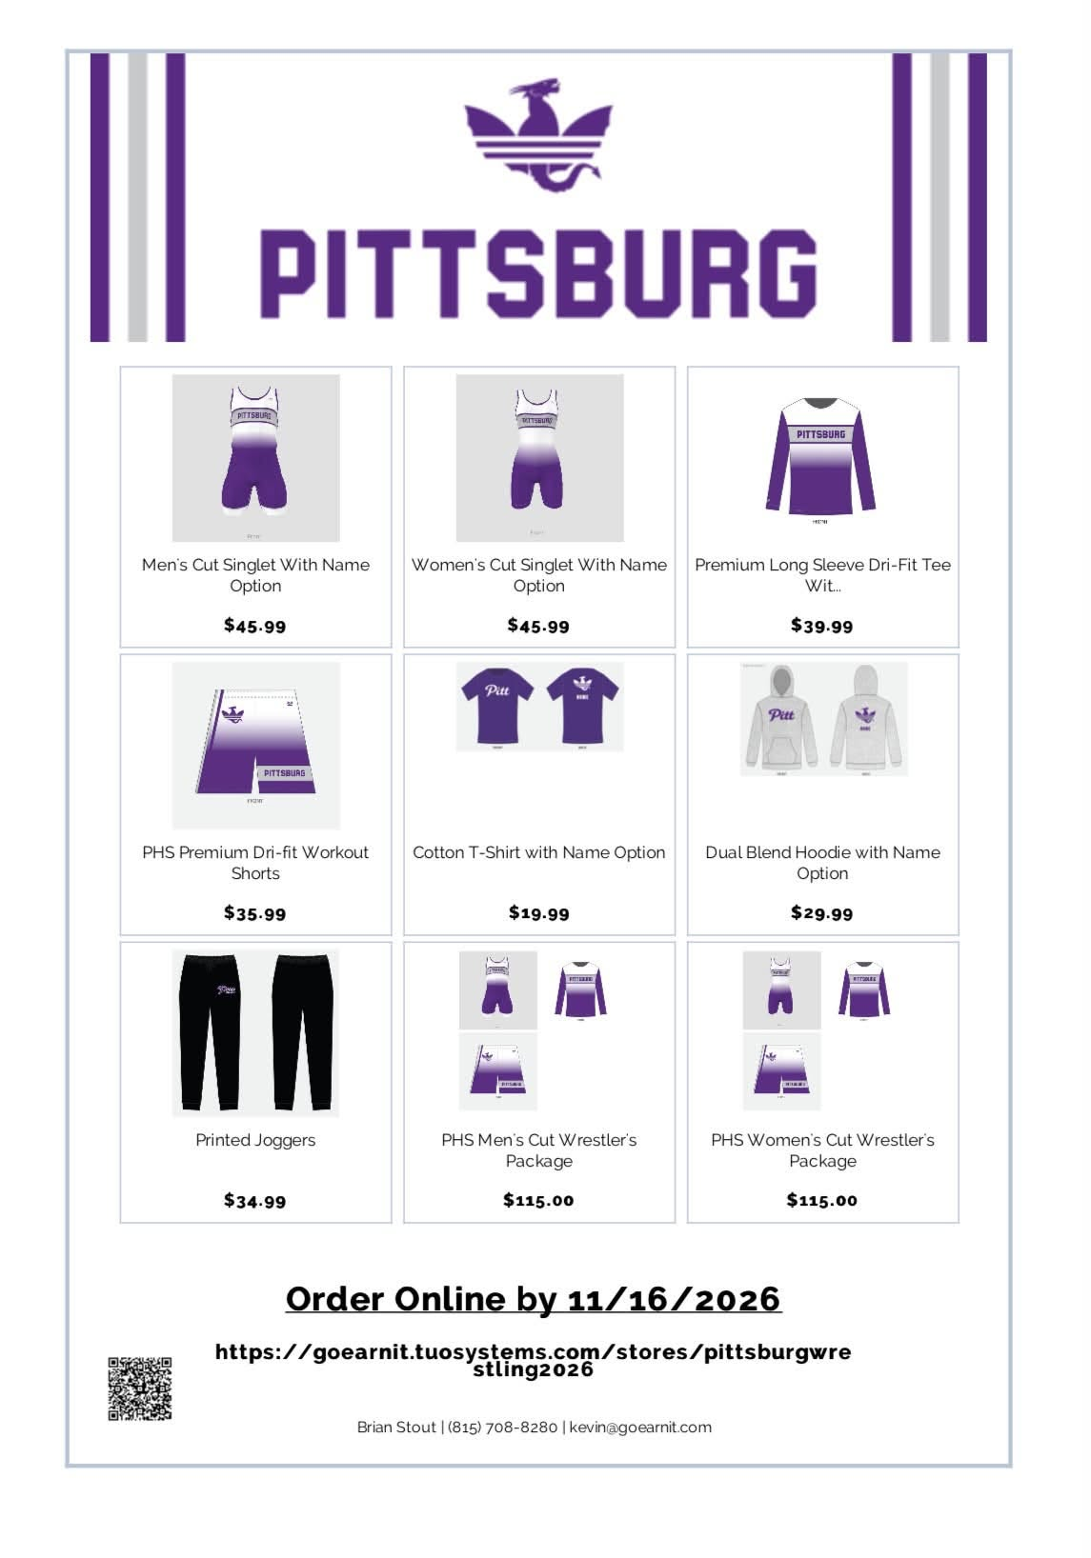
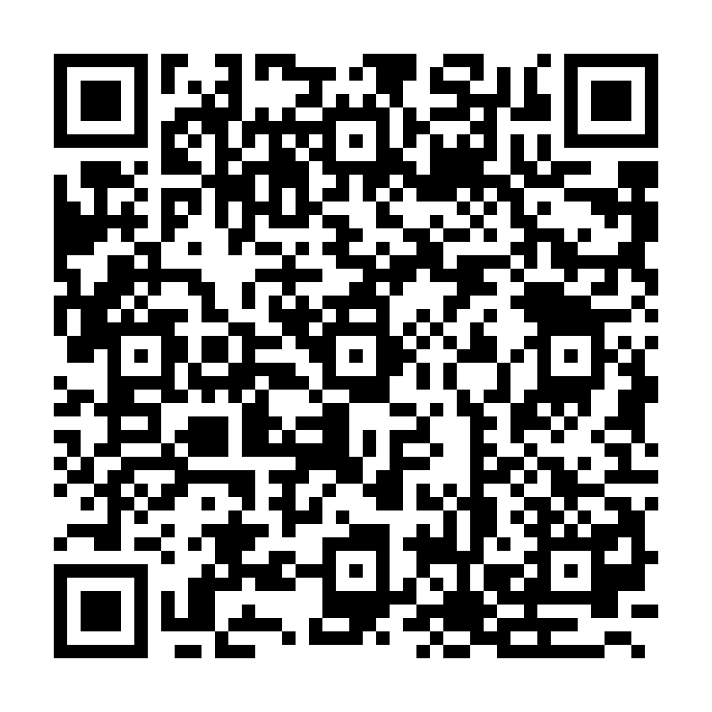
PWC • 2026–27
Order your 2026–27 Dragon gear
GO EARN IT
ONLINE GEAR STORE
NOVEMBER 16
MIDNIGHT DEADLINE
Singlets, wrestler packages, tees, hoodies, shorts & joggers.
SCAN TO SHOP
goearnit.tuosystems.com/stores/pittsburgwrestling2026
PWCDragons.org
15

Slide 16
PWC • 2026–27
2026–27 Go Earn It pricing
Men’s / women’s singlets
$45.99
Long-sleeve dri-fit tee
$39.99
Dri-fit workout shorts
$35.99
Cotton tee
$19.99
Dual-blend hoodie
$29.99
Printed joggers
$34.99
Wrestler’s package (M/W)
$115.00
The online storefront controls product availability, sizing and customization options.
PWCDragons.org
16

Slide 17
PWC • 2026–27
Fundraising • digital raffle
GUN RAFFLE
100% DIGITAL VIA RAISE365
Make and model: TO BE DETERMINED
Ticket pricing, dates, participation instructions and drawing details: MORE INFORMATION TO COME
Firearm transfer and participation will be subject to applicable law and eligibility rules.
PWCDragons.org
17

Slide 18
PWC • 2026–27
Key fall dates
OCT 18
Dragon Coaches Clinic • SEK Elite • 6 PM
OCT 24
Eric & Johnny Akin Parent/Kid Camp
NOV 01
State Team Scrap with Boo Dryden
NOV 16
Go Earn It gear store closes at midnight
NOV 27
State Team Scrap with Boo Dryden
NOV 30
PWC / SEK Elite Christmas float
DEC 01
PHS Purple & White Dual
DEC 02–03
First Novice / Open practices (per packet)
Sunday Dragon open mats continue at SEK Elite at 1 PM through Nov 8 (7th–12th grade with USAW card).
PWCDragons.org
18

Slide 19
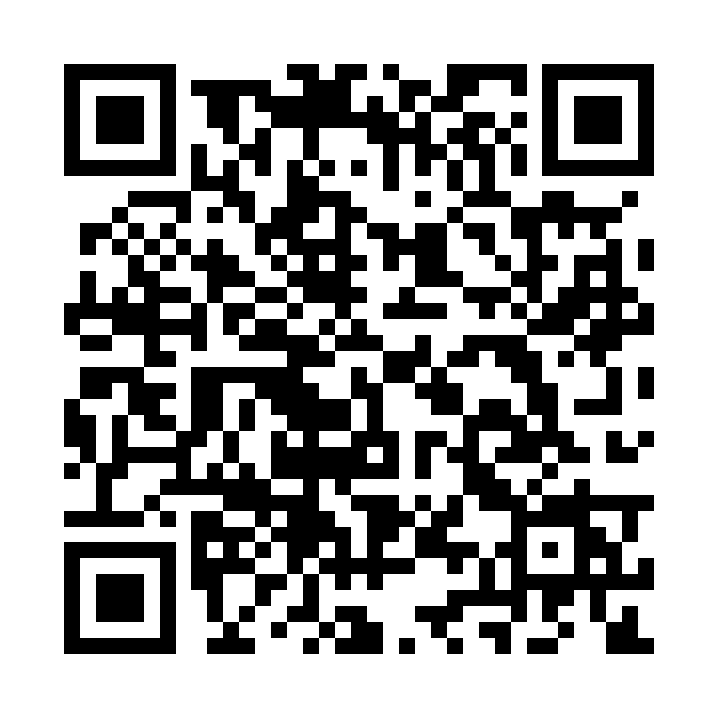
PWC • 2026–27
Stay connected all season
WRESTLINGIQ
CLUB CHANNELS
Primary club communications
Scan to open the website or Facebook page
Calendar and practice changes
Tournament sign-ups & instructions
Instant phone notifications via messaging
PWCDragons.org
Facebook / PWCDragons
Use the dedicated WrestlingIQ slide for app details and setup.
If USD 250 cancels school for weather, PWC practice is canceled.
PWCDragons.org
19

Slide 20
PWC • 2026–27
Before you leave tonight
Get your USAW card FIRST—it is required for PWC registration
Complete wrestler registration at PWCDragons.org
Check practice times and tournament notices in WrestlingIQ
Order Dragon gear by November 16 at midnight
Watch for Raise365 raffle details and volunteer opportunities
Thank you for supporting our wrestlers, coaches and the Pittsburg Wrestling Club!
PWCDragons.org
20

Slide 21
QUESTIONS?
PWCDragons.org
Facebook.com/PWCDragons

